Slide 1





METALLURGY
Nd-YAG
LASER WELDING
Ayushmaan Jaiswal 210005012
Raja Rai 210005036
Ishan Shrivastava 210005021
Vedant Patil 210005050

Slide 2

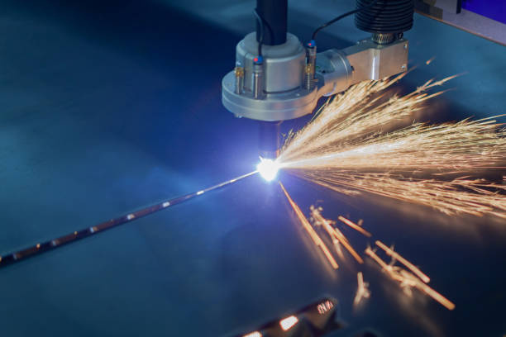
INTRODUCTION:
Nd:YAG (Neodymium-doped Yttrium Aluminum Garnet) laser welding is a well-established technique for joining various metals and alloys.
It utilizes a high powered solid-state laser known as a Nd:YAG laser to create a localized molten pool and join metal components together.
Nd:YAG lasers operate in two variants either pulsed or continuous-wave type, offering versatility in welding applications.

Slide 3
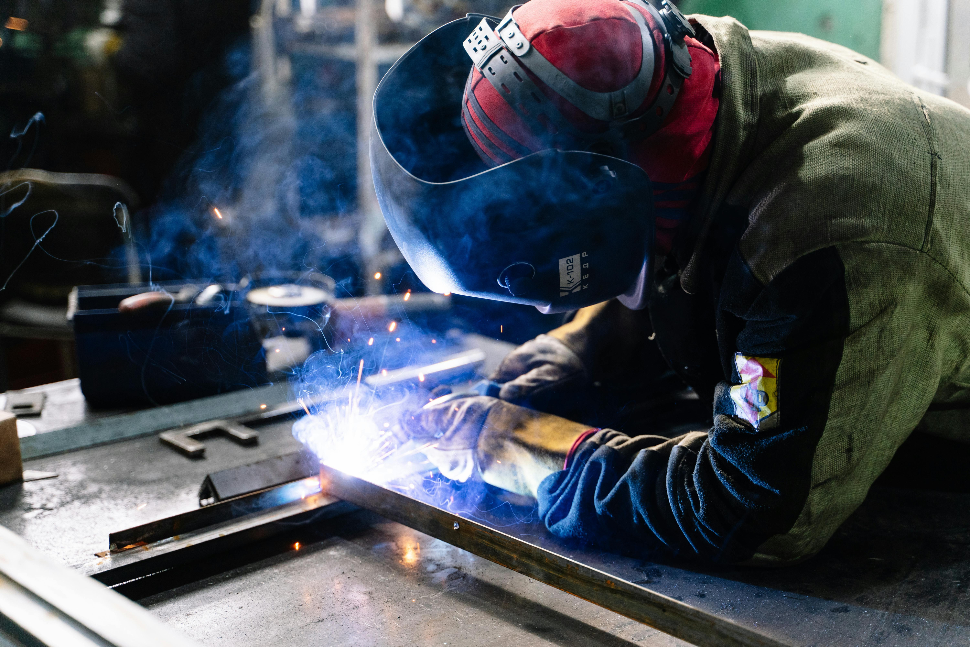
COMPONENTS
01
02
03
Nd:YAG Laser
Beam Delivery System
Welding Head
Flashlamp or diode array
Nd:YAG crystal
Optical resonator
Fiber optic cable
Collimating lenses
Focusing lens
Shielding gas nozzle
r

Slide 4
COMPONENTS
04
05
06
CNC System
Cooling System
Safety Equipment
Motion control system
Laser power control system
User interface
A chiller unit is often used to circulate coolant through the laser and welding head. This helps maintain optimal operating temperature and prevent overheating.
Laser safety enclosure
Fume extraction system

Slide 5
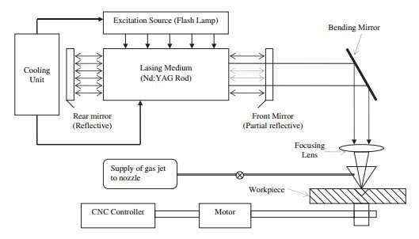
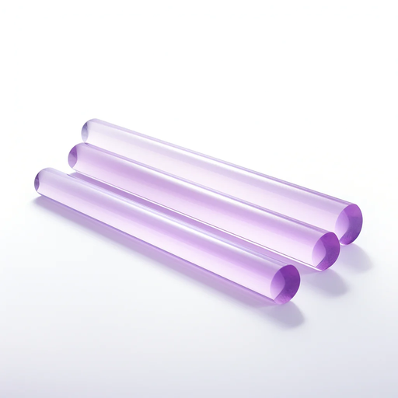
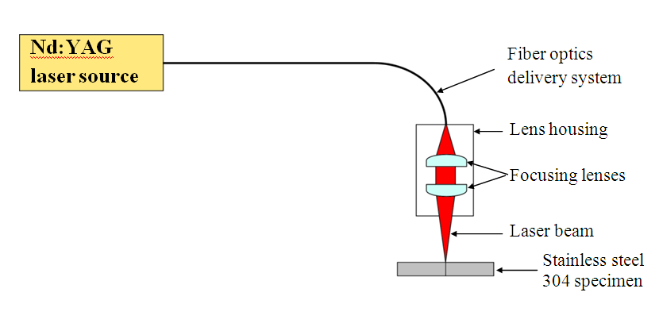
COMPONENTS

Slide 6

WORKING PRINCIPLE
LASER Generation
LASER Amplification
Generation of laser light within the Nd:YAG laser system.
When energy is supplied to the Nd:YAG crystal, typically through flash lamps or diode lasers, the neodymium ions become excited and rise to higher energy levels.
When these ions return to their ground state, they release photons of specific wavelengths, primarily around 1064 nanometers in the infrared spectrum. This process is called stimulated emission.
The emitted photons travel back and forth within the resonator, consisting of mirrors placed at each end of the Nd:YAG crystal. As they pass through the crystal, they stimulate additional neodymium ions to emit more photons of the same wavelength.
This process of stimulated emission results in the amplification of the laser light, producing a coherent and intense beam of light.

Slide 7
WORKING PRINCIPLE
Directing the beam
Welding Process
An optical resonator with mirrors amplifies and shapes the light into a highly focused beam.
The beam then travels through a beam delivery system. This may include collimating lenses to focus the beam and a fiber optic cable (optional) for flexible positioning.
The beam reaches the welding head, where a focusing lens concentrates it further to a tiny spot size at the focal point. This creates an intense heat source.
When the focused laser beam hits the metal surface, the photons are absorbed. This absorption rapidly converts light energy into thermal energy, causing the metal to melt at the point of focus, forming a molten pool.
As the laser beam moves along the desired path, the molten metal behind it cools rapidly due to the surrounding metal acting as a heat sink. This rapid cooling leads to solidification, forming the final weld joint.

Slide 8
WORKING PRINCIPLE
Control System
Cooling and Gas Shielding
Throughout the welding process, various parameters such as laser power, pulse duration, repetition rate, and focal point position are controlled and adjusted by the system's control unit. This ensures precise control over the welding process and the quality of the weld.
Some Nd:YAG laser welding systems incorporate cooling mechanisms to maintain the optimal operating temperature of the laser components.
Additionally, a gas shielding system may be employed to protect the weld area from atmospheric contamination. Common shielding gases include argon and helium, which help prevent oxidation and improve weld quality.

Slide 9
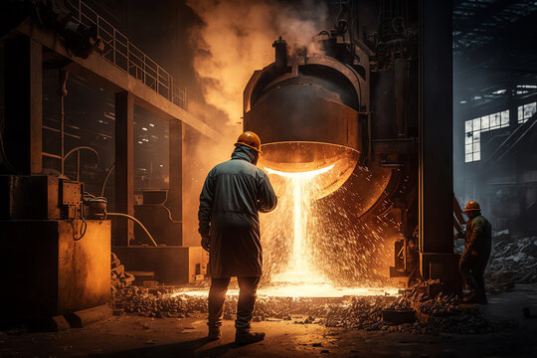


PARAMETERS
Laser Power
Travel Speed
Focal Point Position
Beam Mode
This is the most critical parameter, directly influencing the amount of heat delivered to the material. Higher power leads to deeper weld penetration but also wider heat-affected zones
This determines how fast the welding head moves along the joint. Higher speeds result in less heat input per unit length of weld
This refers to the position of the laser beam's most focused point relative to the workpiece surface.
Nd:YAG lasers can operate in continuous wave or pulsed modes. In pulsed mode, the beam delivery can be further categorized as continuous wave within the pulse or modulated.

Slide 10
ADVANTAGES
1.High Welding Speed
2.Low distortion : due to low heat input
3.Ease of automation
4.Single-pass thick section capability : can do welding in single pass because it has high penetration
5.Better coupling to reflective metals :
Nd:YAG transfer energy efficiently to metals that reflect light.
6.Fiber optic delivery : laser can be delivered through optic cables, hence having greater reach
7.Enhanced design flexibility
8.Reduced Spatter
9.High Precision and Control

Slide 11
DISADVANTAGES
High Initial Investment
2.Joint Accessibility
3.Reflectivity Concerns
5.Limited Material Thickness for Thin Materials
6.Safety Considerations
4.Process Complexity

Slide 12





APPLICATIONS
I
Automotive Industry
Aerospace Industry
Electronics Industry
Medical Industry
Creating high-strength welds in aircraft structures
Joining titanium and other high-strength alloys used in aerospace applications.
Welding delicate components in jet engines.
Precisely welding delicate components in circuit boards for miniaturization and high packing density.
Joining electrical contacts
heat sinks and battery enclosures.
Joining intricate parts in pacemakers, stents, and surgical instruments for biocompatibility and precision function.
Welding components in medical implants within the human body.
.
Joining car body components like doors, hoods, and trunks.
Welding intricate parts in engines and transmissions for lightweight and high-performance designs.

Slide 13
UNDERSTANDING MICROSTRUCTURE AND MECHANICAL PROPERTY USING AN EXPERIMENT
Abstarct
What is INCOLOY alloy ?
Why INCOLOY alloys can’t be joined using conventional welding techniques ?
What are we doing here?
Joining of incoloy alloy 800 using Nd-YAG laser welding, and then analysing the evolved microstructure during the process, and then we would try to relate the evolved microstructure with the mechanical properties.
Its a kind of superalloy, which can withstand very high temperatures. Following is the composition of our alloy.
1)Micro fissuring in the HAZ
2) Elemental segregation, formation of Laves phases, or brittle intermetallic compounds in the interdendritic regions forming during weld metal solidification
3) The fusion zone is therefore weakened because of significant dilution of alloying elements from the original alloy.
4)They are prone to crack initiation and subsequent propagation because of their intrinsic brittle nature
How to overcome this problem?
Utilizing welding processes associated with high cooling rates and low heat input, hence laser beam welding.

Slide 14
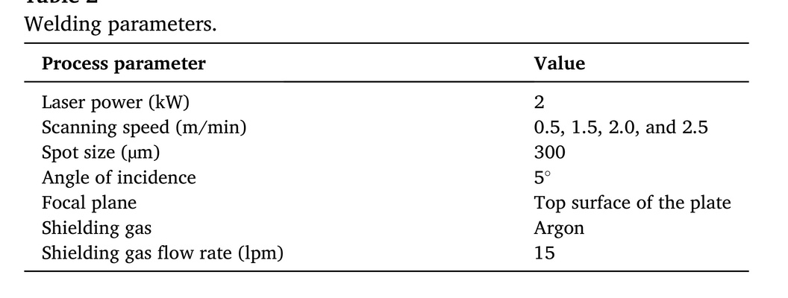
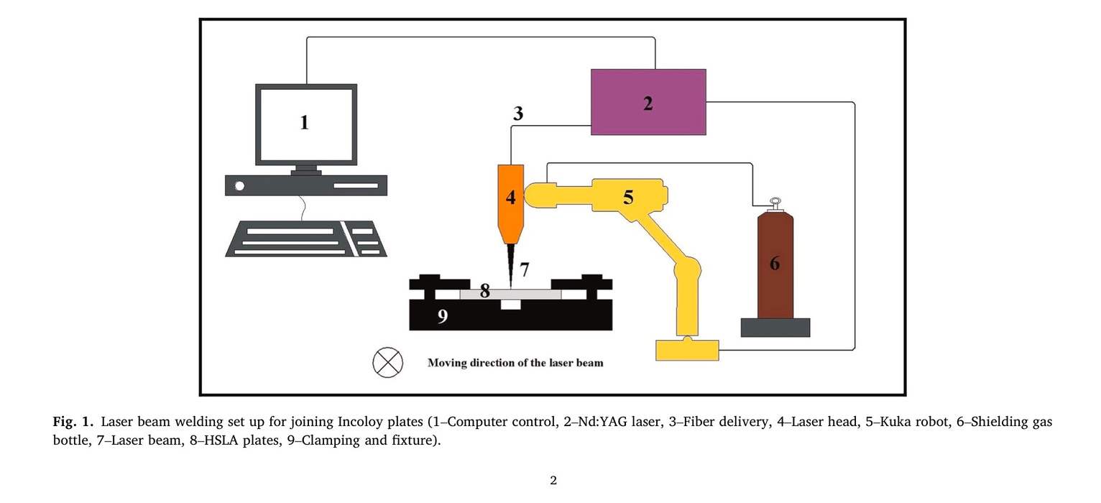
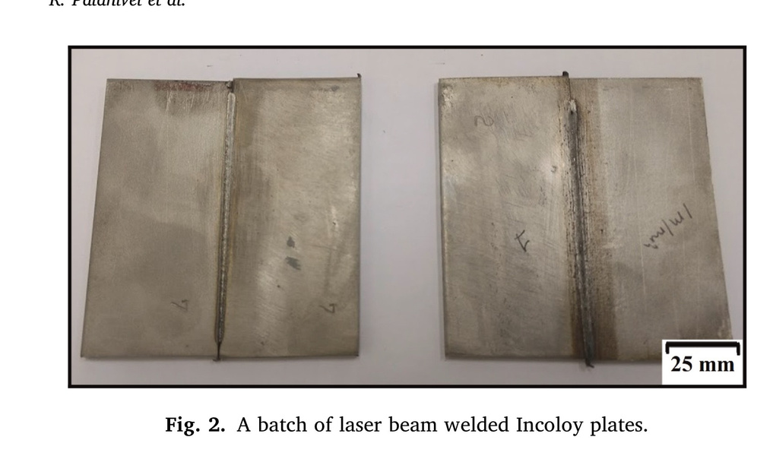
Experimental Setup
4 mm thick Incoloy alloy 800 sheets that were cut into 100 × 50 mm specimen
A 4.4 kW YAG laser ( explain Nd YAG )

Slide 15
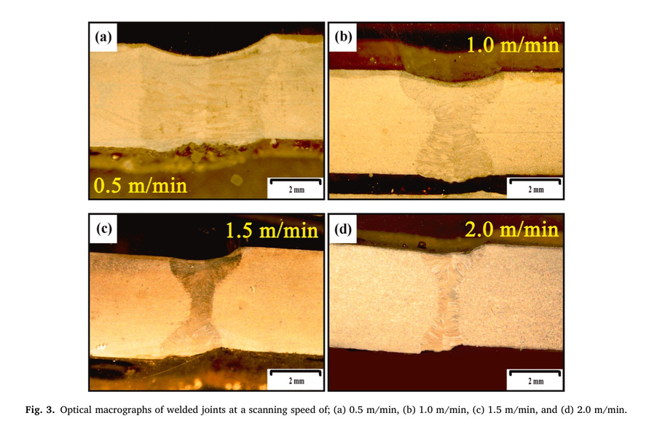
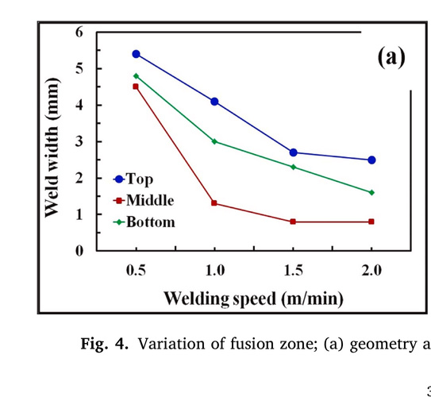

RESULTS AND DISCUSSION
Macrostructure
Fig. 3 illustrates the macrographs of the joint region of the Incoloy alloy 800 laser welded plates.
Joint lines were fully fused, suggesting effective joints under all welding conditions
The fusion zone does not exhibit excessive convexity, underfills or cuts. All joints have full penetration. No excessive expulsion of molten metal at the joint root is observed
Neither cold cracking nor hot cracking was apparent due to absorption of hydrogen and absence of segregation
The fusion zone also displays limited evidence of porosity that is associated with un- wanted gas entrapment
The width of the joint was greatest at the top for all scanning speeds
indicating a reduced heat transfer at the bottom.

Slide 16
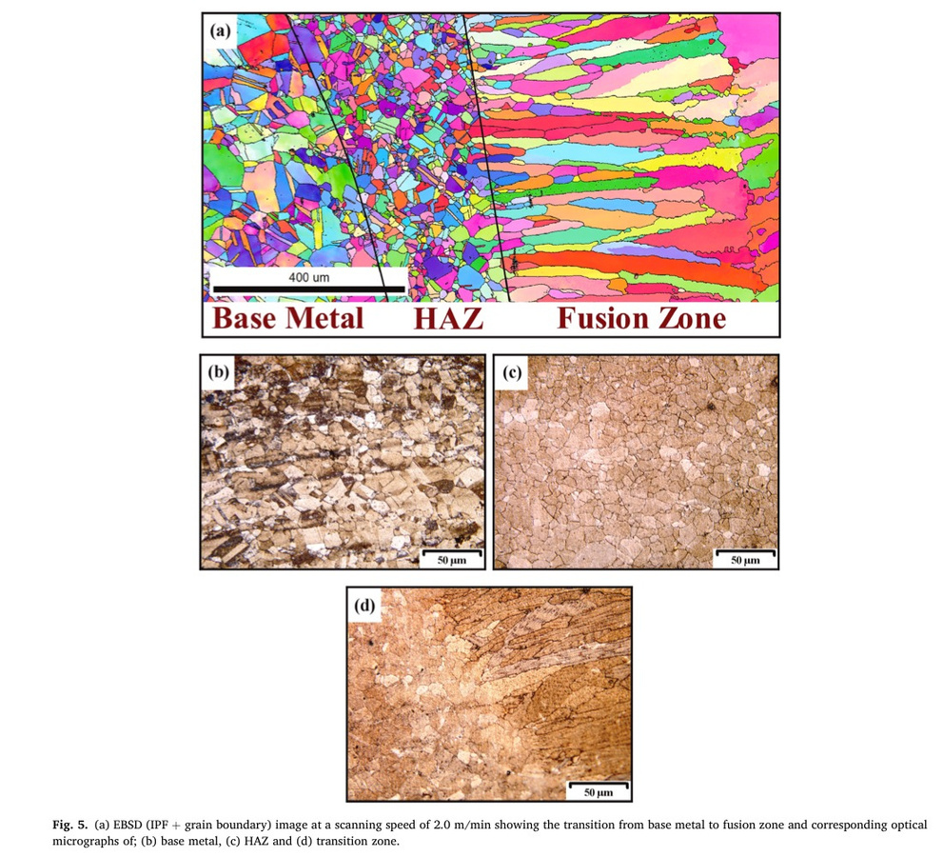
Microstructure
Fig. 5 presents one EBSD micrograph (Fig. 5a) displaying an edge of the fusion zone and the corresponding optical micrographs for the 2 m/ min scan speed.
Phase transformation and grain size variation were considered to identify the boundaries of each zone
The original base metal structure is transformed due to the laser heat causing melting in the center
Grain size changes and phase changes do occur in the HAZ , but Conversely, the fusion zone underwent full melting and dramatic changes due to the resolidification and subsequent cooling.

Slide 17
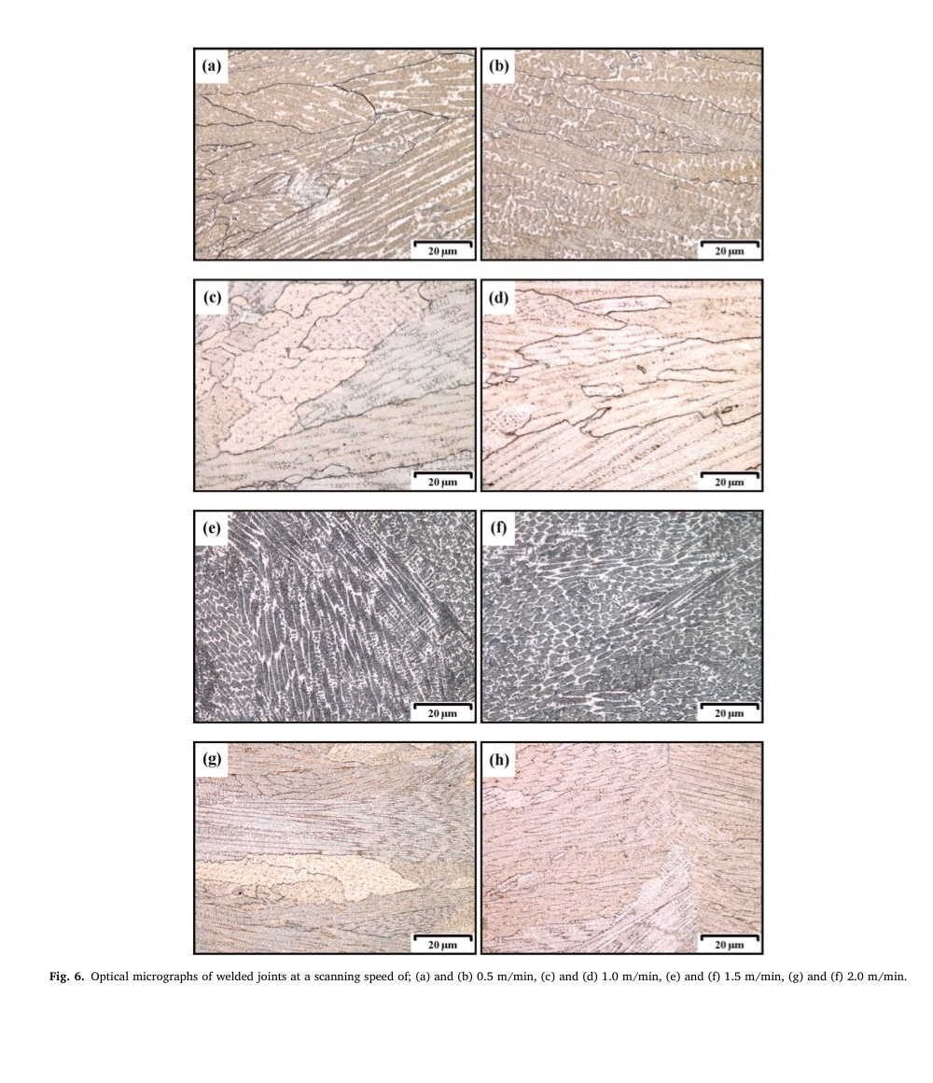
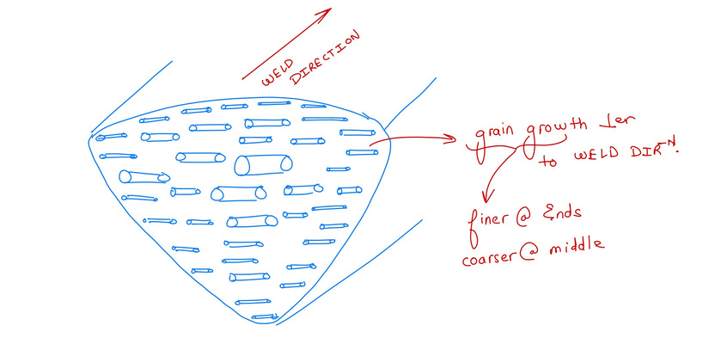
Fig. 6 presents micrographs (optical) of the fusion zone at different scanning speeds.
This region displayed was directly beneath the joint line (laser beam focus point) and was fully molten during the process.
As the laser head scans further away the molten region (bound by the unmelted base metal) starts to cool and solidify. Nucleation then commences and large columnar austenite grains form that grow in size (perpendicular to the weld line) in the molten pool
no micro fissuring , it’s fully austenite
The growth occurred perpendicular to the weld zone with a characteristic slender columnar shape at the fusion zone edge that becomes large as the center of the weld is approached
This is due largely to the heat conduction away from the weld pool towards the base metal

Slide 18
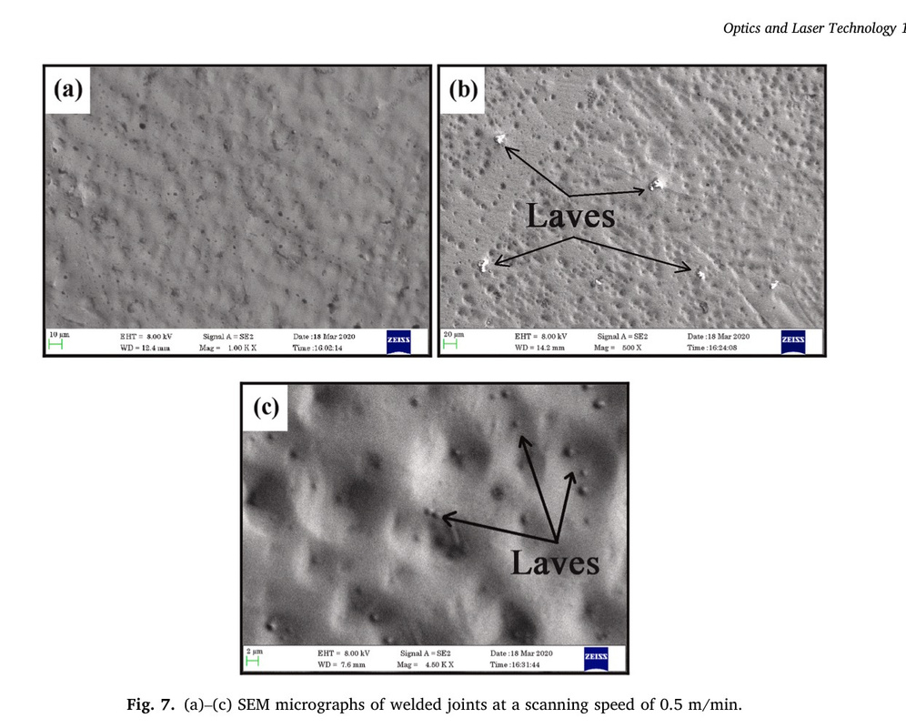
Scan speed = 0.5 m/s
lower speed hence laves phase
Laves phases are intermetallic phases of composition with a spherical sealed packed structure
decrement in chemical homogenisation, since it absorbs solute atoms such as Mo, Si, and Ti which are then depleted from its surroundings.
quite brittle hence affects mechanical properties
If present in significant quan- tities, these Laves phases can lead to a breakdown of material properties by absorbing large concentrations of solute atoms which are the primary hardening elements of the super alloys.
can be avoided at lower heat input or higher scanning speed , since in that case time for atomic segregation won’t be there
proof of this point is on next page

Slide 19
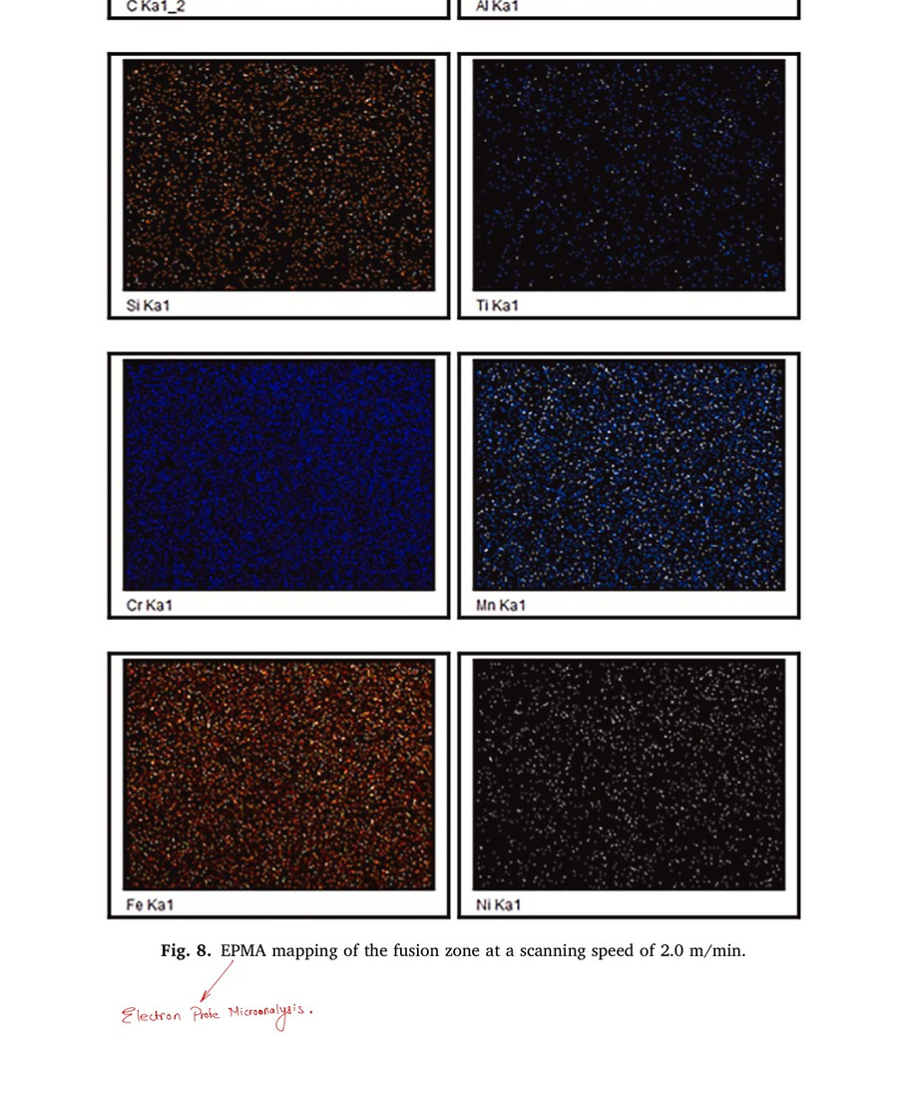
Fig. 8 shows an EPMA mapping of the fusion zone for a scanning speed of 2.0 m/min.
no atomic segregation, uniform atomic distribution at high scanning speed
NOTE: EPMA-ELECTRON PROBE ANALYSIS

Slide 20
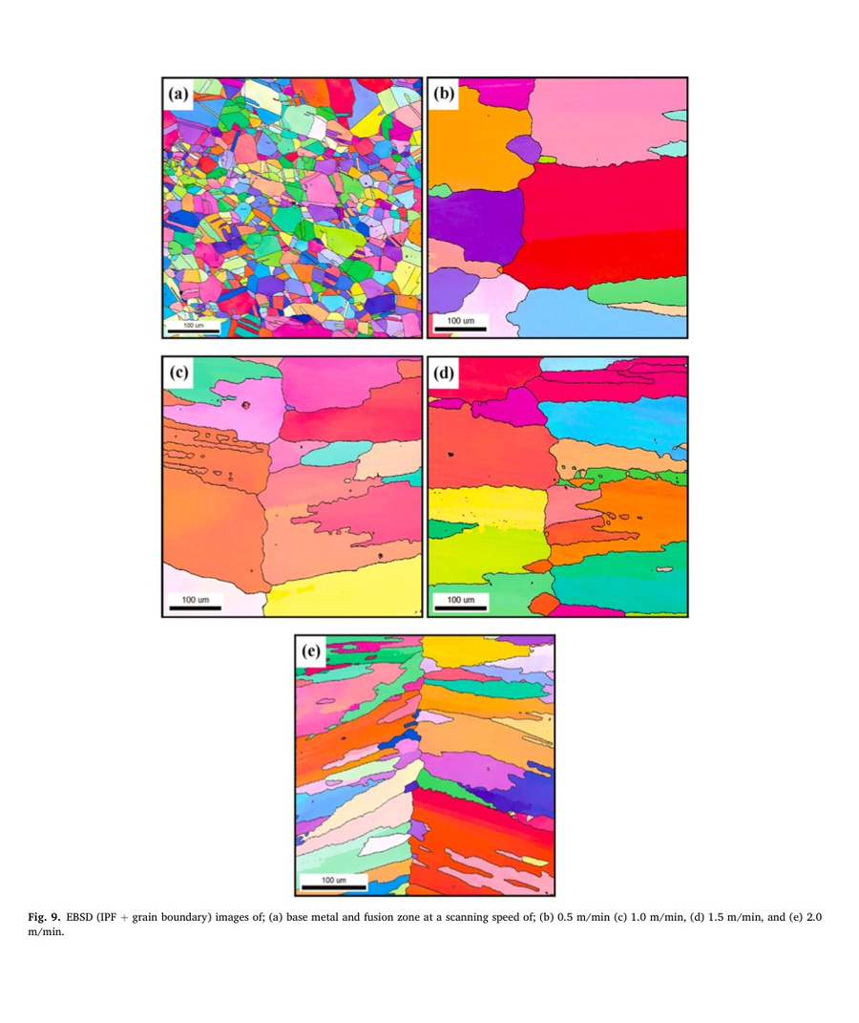
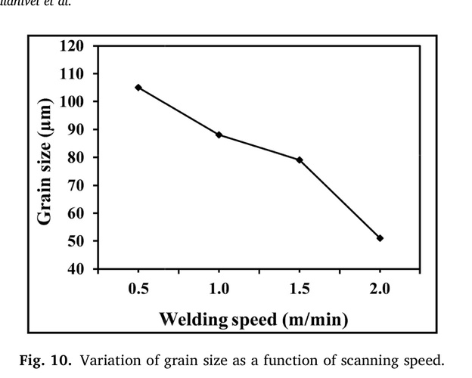
EBSD images from the base metal along with the center of the fusion zone are presented for various scanning speeds in Fig. 9
The base metal average grain size was found to be 9 μm
repeated black marks = pearlite ( another example of atomic segregation)
Grain size is inversely proportional to scanning speed.
reason - The larger heat inputs associated with the lower scanning speeds implies lower cooling rates and adequate time for the austenite grains to coarsen.

Slide 21
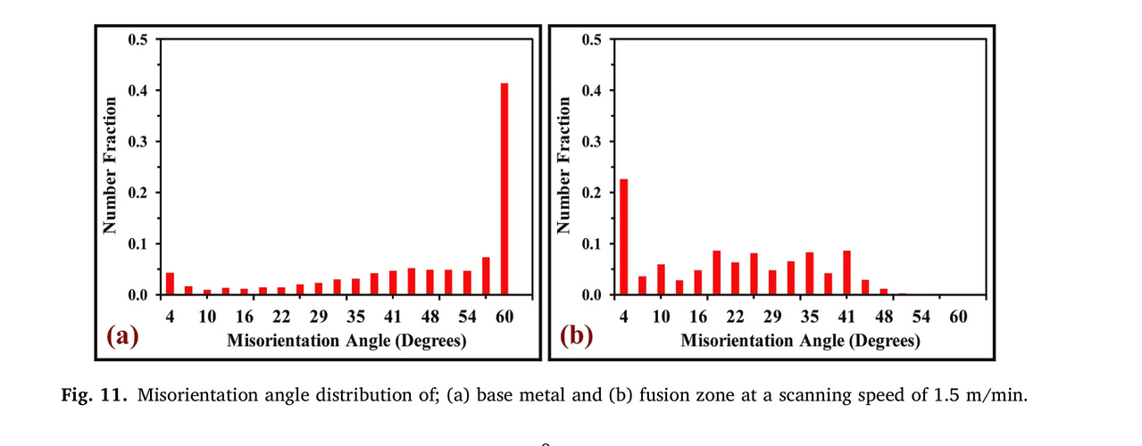
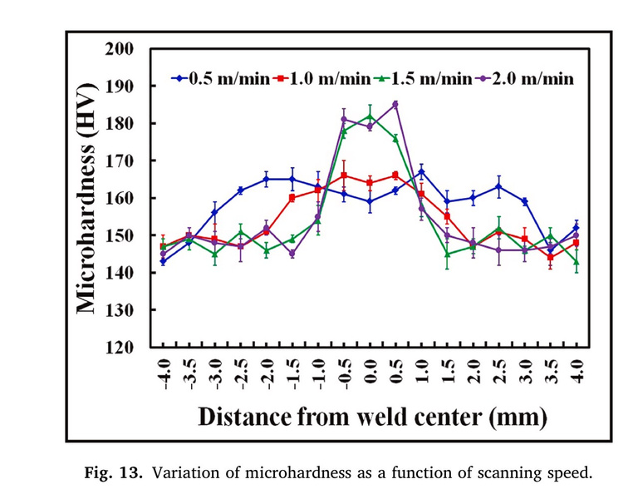
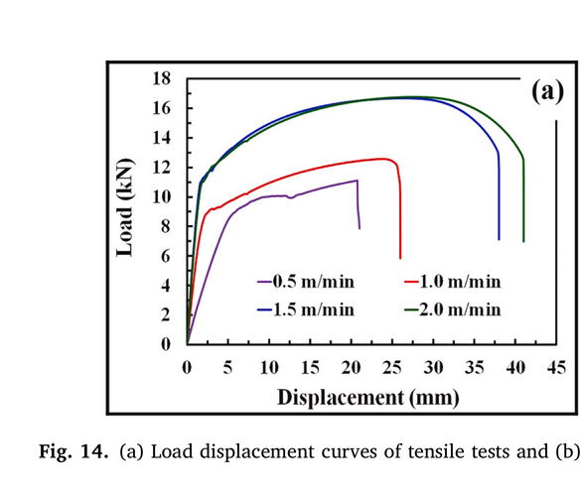
showing grain misorientation for base metal and fusion zone for scanning speed = 1.5 m/s
HAGB = base metal and LAGB = fusion zone
reason = This finding indicates that increasing scanning speed leads to more substructure boundaries being formed within the fusion zone while the grain boundaries are significantly reduced.
Mechanical properties
The variation of microhardness across the weld joint at the central line for various scanning speeds is presented in Fig. 13.
weld joint had higher hardness as compared to the base material
One would think that hardness is more in weld zone then definitely the grain size would be lower there, it’s thats not the case , the grain size of weld zone is greater than that of base material.
so real reason - strain induced dislocations
these strain induced dislocations are impinged and blocked by LAGBs ( we have earlier discussed that fusion zone has LAGBs)
hardness is directly proportional to scanning speed

Slide 22
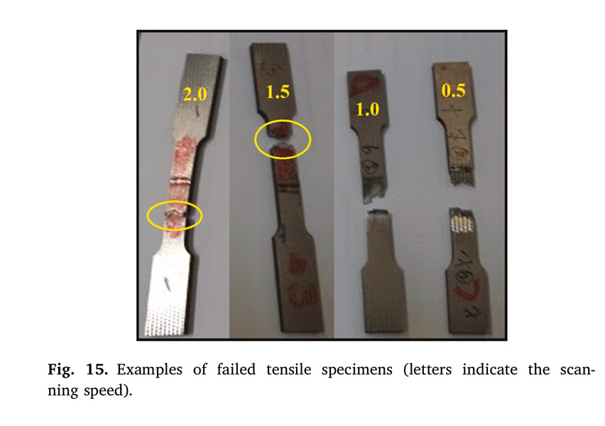
Joint Efficiency ( most important mechanical property )
A joint efficiency (maximum) of 99% was therefore demonstrated at the scanning speeds of 1.5 and 2 m/min.
The joint efficiency is clearly illustrated by noting the joint fracture position.
low scanning speed = fracture on or near the HAZ
reason , low scanning speed = high heat input = laves phase formation = increased brittleness
high scanning speed = fracture in base material
reason , high scanning speed gave weld zone higher hardness.

Slide 23
CONCLUSION
Columnar dendritic grains in the fusion zone with grain growth occurring perpendicular to the weld zone boundaries. The grain structure became finer and equiaxed with increased scanning speeds due to the reduced heat input and the associated higher cooling rate.
HAZ displayed no significant changes in grain size but phase trans formation was observed. The presence of Laves phases was noted at the lower scanning speeds which eventually had an effect on their strength and hardness.
EBSD images showed how the austenitic grain size decreased with increasing scan speed. TEM Micrographs confirmed the presence of Laves phases and showed irregular and planar dislocations along with sub grain boundary structure.

Slide 24
REFERENCES
https://doi.org/10.1016/j.optlastec.2021.107039
https://doi.org/10.4028/www.scientific.net/AMR.383-390.6247
https://www.phase-trans.msm.cam.ac.uk/2011/laser_Walsh_review.pdf

